Slide 1
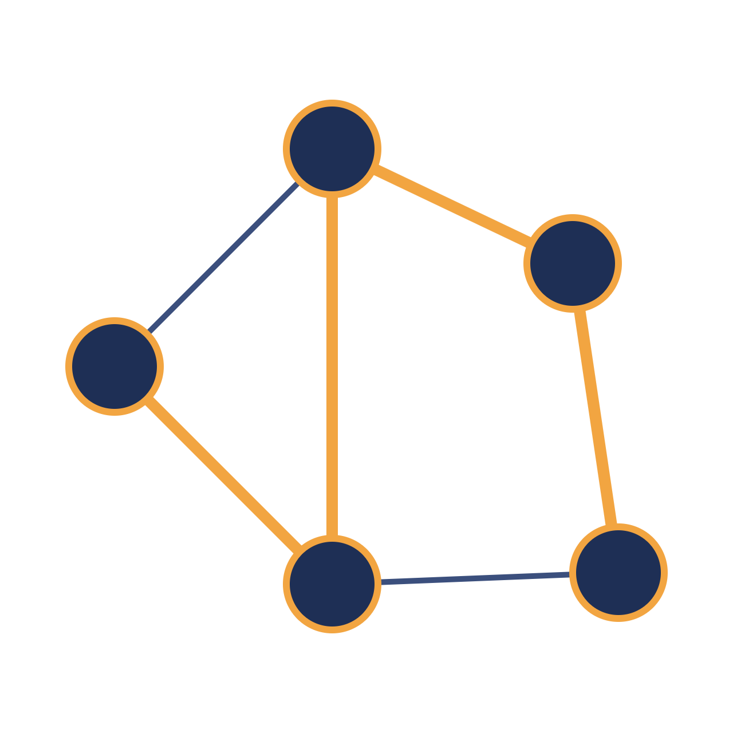
Dijkstra’s
Algorithm
ALGORITHMS · GRAPH THEORY
Finding the shortest path in a weighted graph
Data Structures and Algorithms
Made with Claude
Notes:
Welcome. This deck explains Dijkstra’s algorithm: what problem it solves, how it works, a worked example, its cost, its limits, and where it is used.

Slide 2
Shortest path in a weighted graph
THE PROBLEM
Given a starting vertex, find the cheapest route to every other vertex.
Input
Output
Example
A graph with non-negative edge weights and one source vertex.
The minimum total weight from the source to every other vertex.
On a road map, junctions are vertices and road lengths are weights.
Dijkstra’s Algorithm · 02
Made with Claude
Notes:
Set up the problem. A weighted graph has a cost on every edge. We want the cheapest route from one source to all other vertices. Dijkstra’s algorithm requires every weight to be zero or positive.

Slide 3
Edsger W. Dijkstra
ORIGINS
A Dutch computer scientist (1930–2002) who devised the algorithm to show what a computer could do with a simple problem.
1956
1959
1972
Conceives the algorithm, reportedly in about twenty minutes.
Publishes it in the journal Numerische Mathematik.
Receives the Turing Award for his work on programming languages.
Dijkstra’s Algorithm · 03
Made with Claude
Notes:
Dijkstra worked it out in 1956 and published a short note in 1959. He won the Turing Award in 1972, for fundamental contributions to programming languages and the discipline of structured programming.

Slide 4
Always settle the closest unvisited vertex next.
THE CORE IDEA
With non-negative weights, no later route can beat the shortest known distance to that vertex, so its distance is final.
Greedy choice
Relaxation of edges
Dijkstra’s Algorithm · 04
Made with Claude
Notes:
The key insight. Among all unvisited vertices, the one with the smallest known distance cannot be improved later, because every other path would have to pass through a vertex that is at least as far away. Relaxation means checking whether going through the newly settled vertex gives a shorter route to its neighbours.

Slide 5
The algorithm in four steps
HOW IT WORKS
1
2
3
4
Initialise
Pick
Relax
Repeat
Set the source distance to 0 and every other vertex to infinity.
Choose the unvisited vertex with the smallest known distance.
For each neighbour, keep the smaller of its old distance and the new route.
Mark the vertex visited and loop until every vertex is settled.
Dijkstra’s Algorithm · 05
Made with Claude
Notes:
Walk through the four steps. Initialise distances, repeatedly pick the closest unvisited vertex, relax its outgoing edges, and stop when every vertex has been settled. Next slide shows this on a small graph.

Slide 6
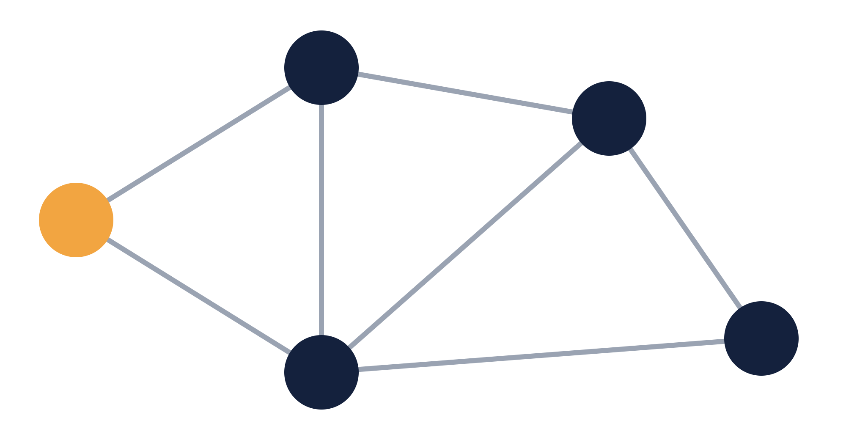
A graph with five vertices
WORKED EXAMPLE
B
5
D
Goal
4
Find the shortest distance from source A to every other vertex.
A
1
8
2
Edge weights
2
All non-negative, as the algorithm requires.
E
C
10
Dijkstra’s Algorithm · 06
Made with Claude
Notes:
Our example graph. The source A is highlighted in amber. Edge weights are shown on each edge: A-B 4, A-C 2, B-C 1, B-D 5, C-D 8, C-E 10, D-E 2. The next slide traces the algorithm step by step.

Slide 7
Distances after each step
WORKED EXAMPLE
Step | Visit | A | B | C | D | E
Start | none | 0 | ∞ | ∞ | ∞ | ∞
1 | A | 0 | 4 | 2 | ∞ | ∞
2 | C | 0 | 3 | 2 | 10 | 12
3 | B | 0 | 3 | 2 | 8 | 12
4 | D | 0 | 3 | 2 | 8 | 10
5 (final) | E | 0 | 3 | 2 | 8 | 10
Shortest path to E: A → C → B → D → E, total cost 10.
Dijkstra’s Algorithm · 07
Made with Claude
Notes:
Read the table row by row. Visiting A sets B to 4 and C to 2. Visiting C improves B to 3 and sets D to 10 and E to 12. Visiting B improves D to 8. Visiting D improves E to 10. The last row holds the final shortest distances from A.

Slide 8
Pseudocode
HOW IT WORKS
dist
function Dijkstra(graph, source):
Best known distance from the source to each vertex.
for each vertex v:
dist[v] = infinity
dist[source] = 0
prev
queue = all vertices, keyed by dist
The vertex before each one on its best path, used to rebuild routes.
while queue is not empty:
u = vertex in queue with smallest dist
remove u from queue
queue
for each neighbour v of u:
alt = dist[u] + weight(u, v)
A priority queue that returns the closest unvisited vertex.
if alt < dist[v]:
dist[v] = alt
prev[v] = u
return dist, prev
Dijkstra’s Algorithm · 08
Made with Claude
Notes:
The whole algorithm in a few lines. The inner if statement is the relaxation step. The prev array lets you rebuild the actual path by walking back from any target to the source.

Slide 9
Time complexity
ANALYSIS
Priority queue | Running time | When it fits
Simple array | O(V²) | Dense graphs with many edges
Binary heap | O((V + E) log V) | Sparse graphs, the common choice
Fibonacci heap | O(E + V log V) | Best theoretical bound, rarely worth the complexity
V is the number of vertices and E the number of edges. Memory use is O(V).
Dijkstra’s Algorithm · 09
Made with Claude
Notes:
The cost depends on how you find the closest unvisited vertex. A plain array scan gives O(V squared). A binary heap gives O((V plus E) log V), which is what most libraries use. A Fibonacci heap improves the bound to O(E plus V log V) but is rarely used in practice.

Slide 10
Limits and alternatives
COMPARISON
Algorithm | Edge weights | Running time | Best for
BFS | Unweighted only | O(V + E) | Fewest hops
Dijkstra | Non-negative | O((V + E) log V) with a heap | One source, weighted graphs
Bellman-Ford | Negative allowed, detects negative cycles | O(V × E) | Graphs with negative edges
A* | Non-negative, plus a heuristic | Depends on the heuristic | One source to one target
Negative edges break Dijkstra, because a settled vertex could later be improved.
Dijkstra’s Algorithm · 10
Made with Claude
Notes:
The main limitation is that edge weights must not be negative. The greedy argument fails otherwise, since a longer-looking route might shrink later. Use Bellman-Ford when negative weights exist, BFS for unweighted graphs, and A-star when you only need a path to a single target and have a good heuristic.

Slide 11




Real-world uses
APPLICATIONS
Maps and navigation
Network routing
Games and robotics
Logistics and transit
Protocols such as OSPF and IS-IS compute routes with it.
GPS apps find the fastest route between two places.
Characters and robots plan the cheapest path across a map.
Delivery and transit planners minimise travel time or cost.
Dijkstra’s Algorithm · 11
Made with Claude
Notes:
Anywhere a problem can be modelled as a weighted graph with non-negative costs, Dijkstra’s algorithm or a variant of it is a natural fit. Link-state routing protocols such as OSPF and IS-IS use it to compute shortest paths.

Slide 12
Key takeaways
SUMMARY
It finds shortest paths from one source when all edge weights are non-negative.
It is greedy: settle the closest unvisited vertex, then relax its edges.
With a binary heap it runs in O((V + E) log V) time.
With negative weights, switch to Bellman-Ford.
Dijkstra’s Algorithm · 12
Made with Claude
Notes:
Recap the four points, then open the floor for questions.

